Slide 1
Minimalism
And
Iconography
Important Elements in User Interfaces
JUAN BAEZ
comp4280f2020

Slide 2
Why?
“ With the coming of informatics as a research discipline complementing computer and computing science, the focus moved from the engineering view of reducing excessive complexity to the designing engineer with the aim of reducing complexity for the end user and so ensuring that they would be in command of the procedures employed.”
(Minimalism in Art and Design: Concept, influences, implications and perspectives, Cedric VanEenoo, University of Technology, https://academicjournals.org/journal/JFSA/article-full-text-pdf/3A668BC6040)
“The reason less “visually complex” websites are considered more beautiful is partly because low-complexity websites don’t require our eyes and brain to work as hard to decode, store, and process information”
(Why Simple Website Designs Are Scientifically Better, Tommy Walker, CXL , https://cxl.com/blog/why-simple-websites-are-scientifically-better/)

Slide 3
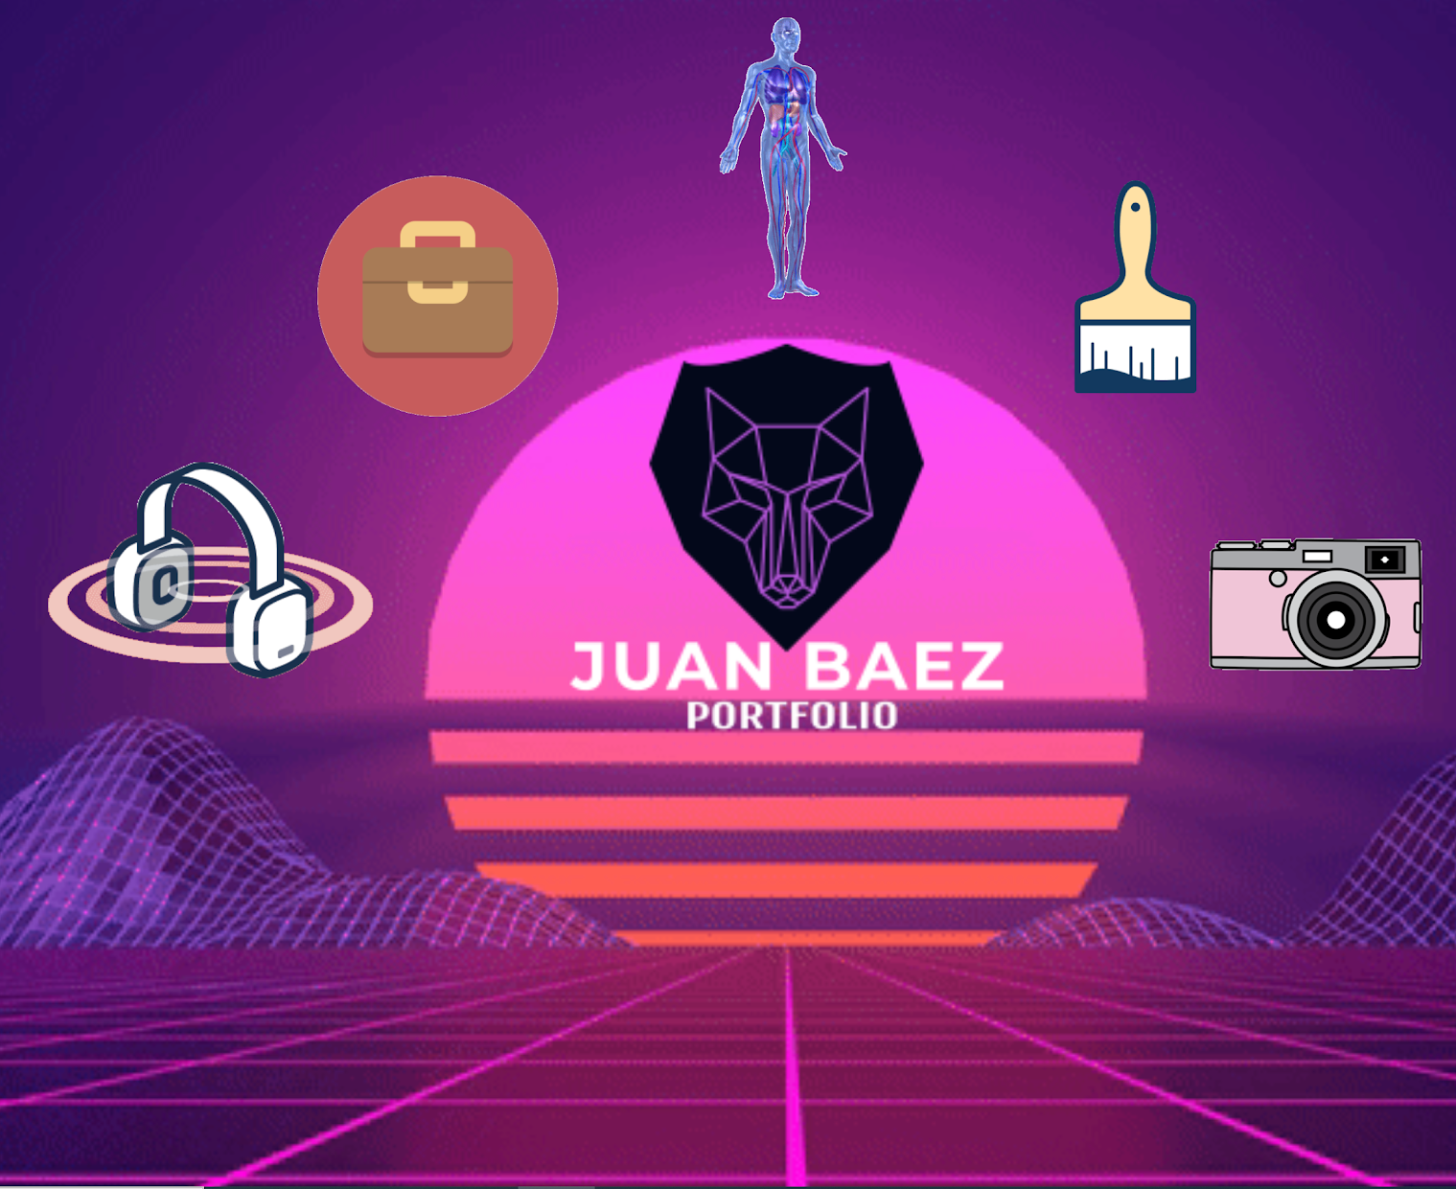
Project: APP HUB (main page/page 1)
Here is the hub page that connects to 5 other original websites of the genres: Music, Career, Fitness, Art, and Photography.
The website uses a decorative, .gif background for visual appeal with css implemented for custom layout.
The website links are animated gif icons that enhance the user experience through visual appeal and easy UI comprehension through minimalism and iconography.

Slide 4
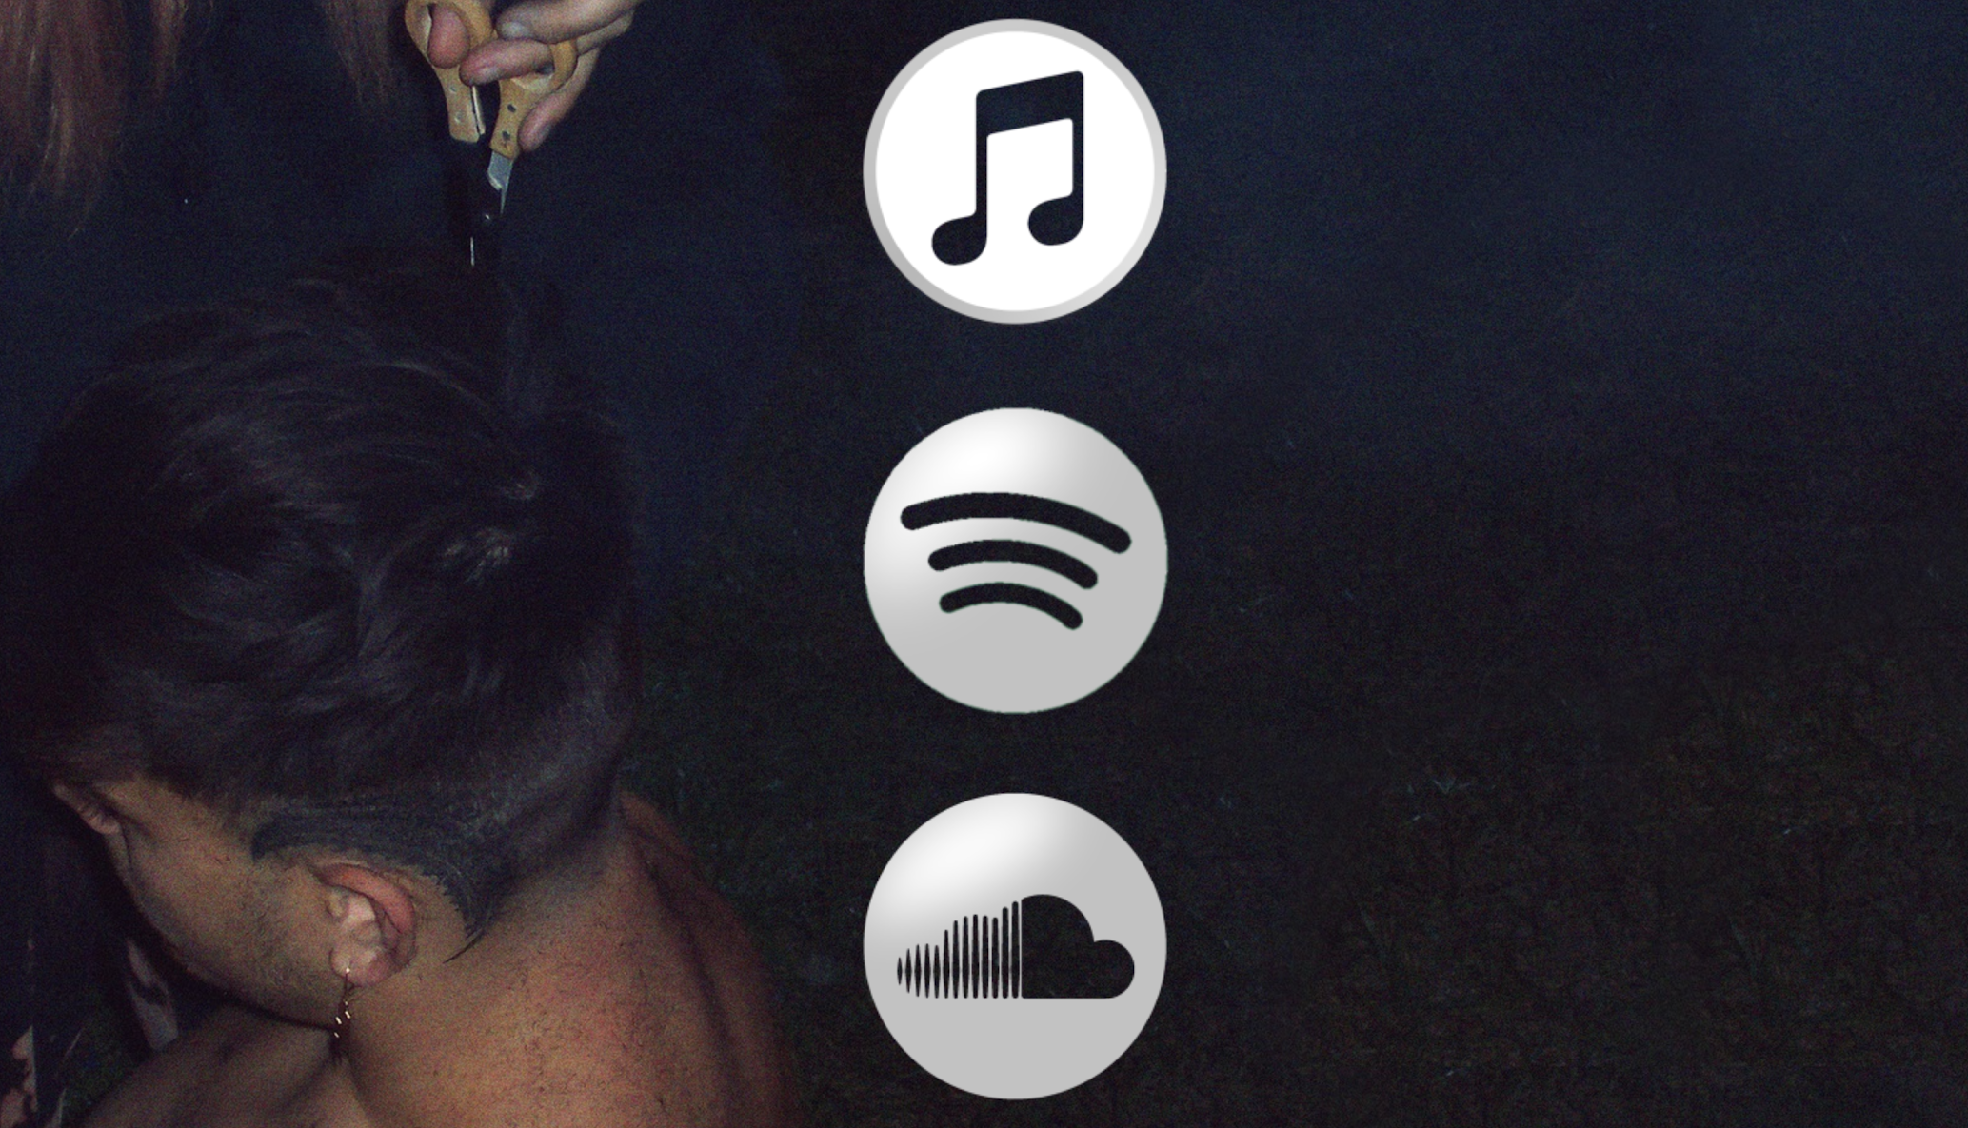
Project: Music Page (page 2)
Here is the music page that connects to the Street Kult artists’ profiles on 3 different music platforms: Apple Music, Spotify, and Soundcloud.
The website loads with a video animation that transitions to an Image background via JS which request the user to click on the “LISTEN HERE” link that allows them to enter this displayed page.
CSS and bootstrap JS were used to decorate the custom layout which is also mobile compatible.
The UI is minimalistic and uses Iconography

Slide 5
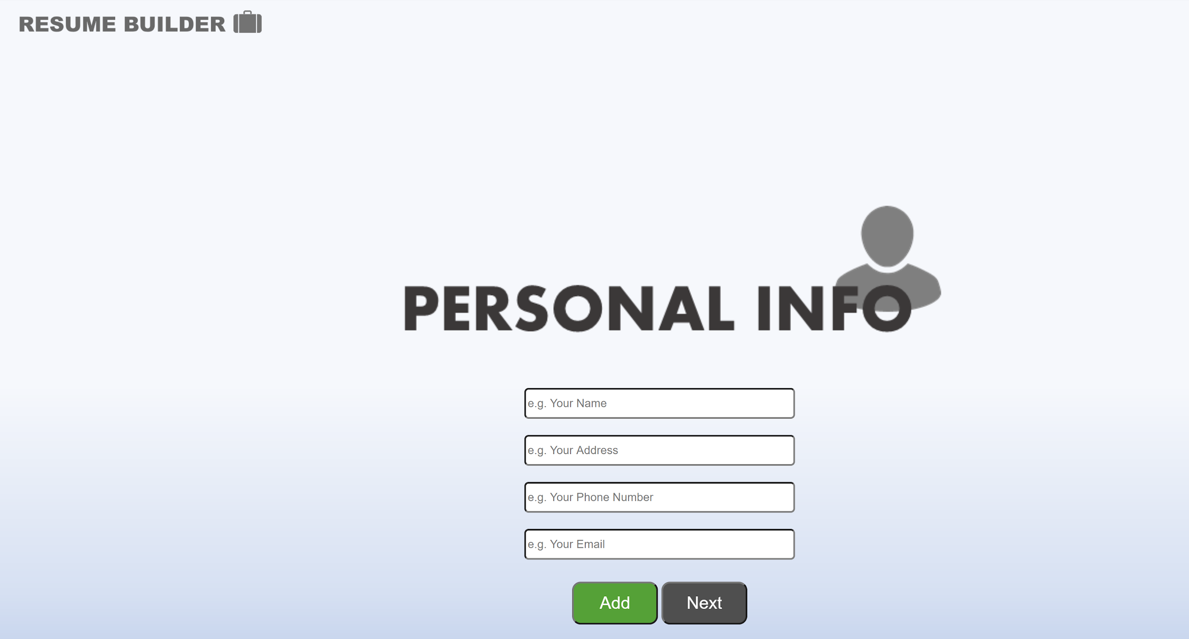
Project: Career Page (page 3)
Here is the career page that allows a user to interact with the text inputs to create their own resume. As input is added by clicking “Add”, the content appears in the open space to the left of the UI.
As the user clicks “Next” , the added data is then carried over into the next page where the user enters the next category of resume info and then the info is appended to the data thus forming the cumulative resume.
This UI uses minimalism and iconography, and the design style allows the user to understand it with little to no learning curve. The UI also uses JS to display a gif animation as the intro when the site loads.

Slide 6
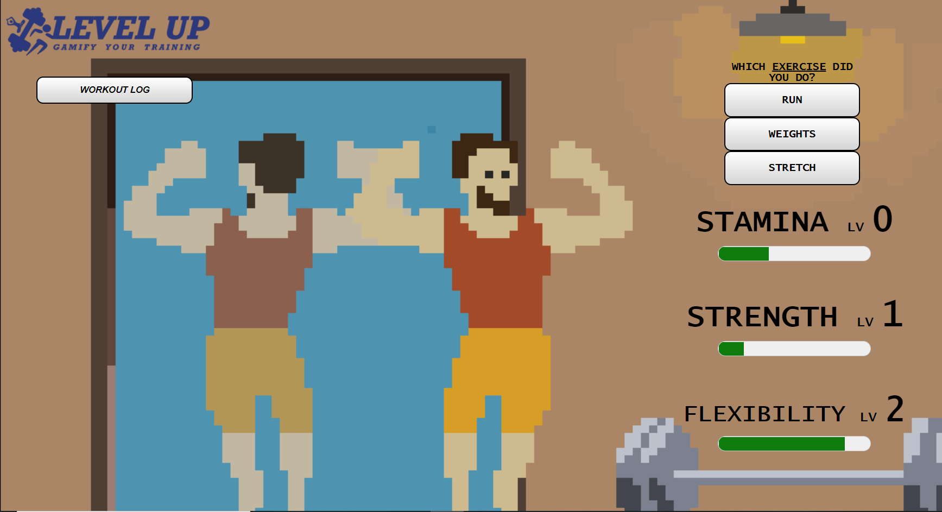
Project: Fitness Page (page 4)
Here is the fitness page that allows a user to select a workout from the menu to the right which then brings them to a uniquely decorated page where they can enter data on their workout. According to the input, experience points are then added to the user’s stat bars which allows them to record their progression.
A workout log button is also provided so the user can see a list of all their workouts labeled with a workout icon and a timestamp along with their input workout info.
The UI is decorative with a wide use of gifs, and multiple gifs placed together to form a decorative scene. The UI is simple, but the JS backend allows for high functionality with workout recording with data visualizations.

Slide 7
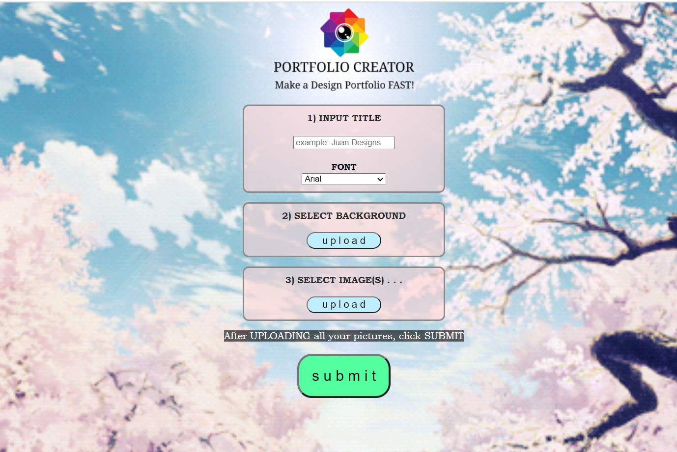
Project: Art Page (page 5)
Here is the art page that allows a user to automatically create a unique art portfolio page by doing just a few simple steps: input title and select font, upload a background image, and upload your designs to be showcased.
When the submit button is clicked, a new page is loaded that contains your title, background, and showcased images as thumbnails which can be clicked on too “zoom-in” to a larger view.
The UI uses minimalism by keeping the UI steps minimal yet maintaining high functionality by being able to auto-generate a portfolio webpage (via JS) based off minimal user effort/input.

Slide 8
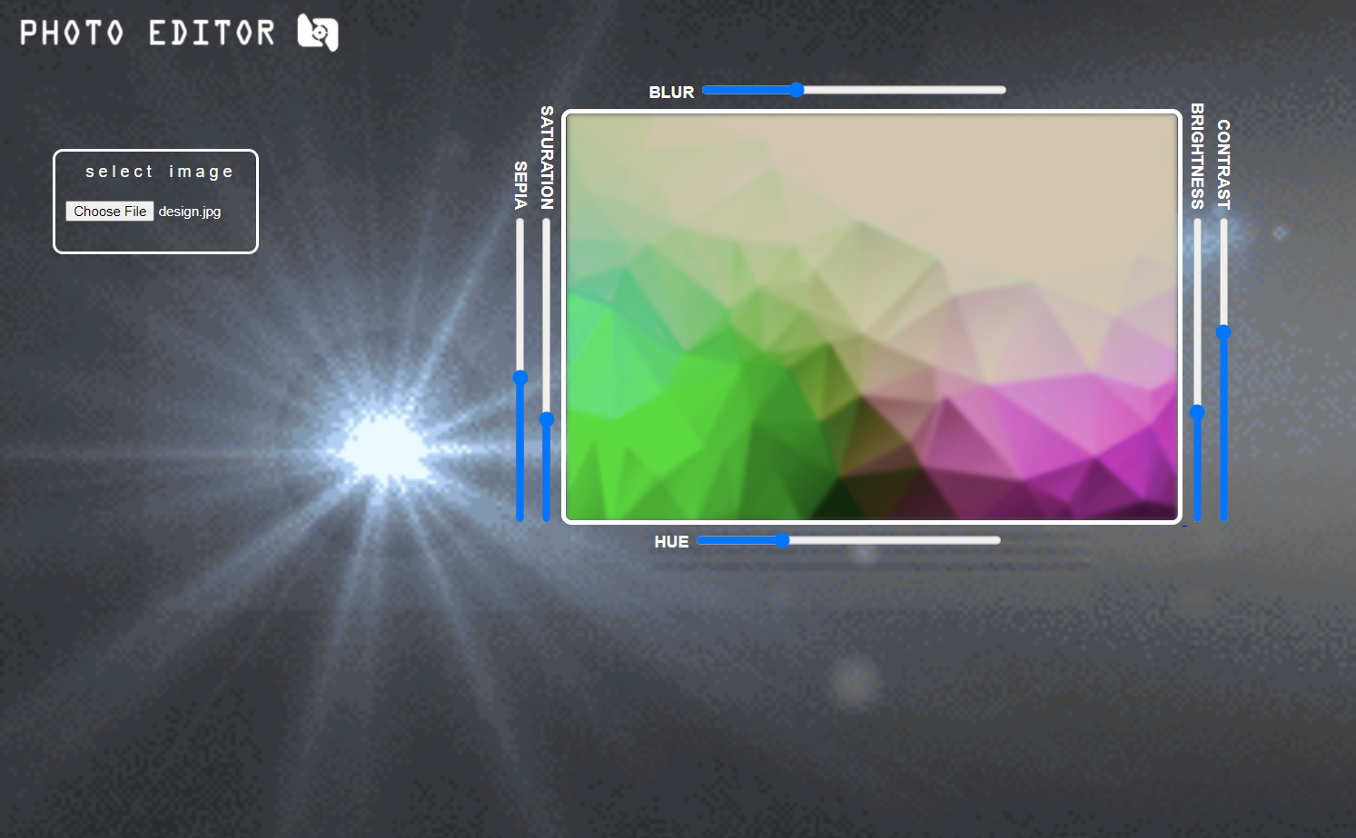
Project: Photography Page (page 6)
Here is the photography page that allows a user to upload an image and edit it. Once the image is uploaded, a design interface appears along the perimeter of the image. The user can click the image to download it once editing is done.
This UI uses minimalism by containing limited, yet essential elements. The interface is intuitive and straightforward yet it maintains high functionality via JS implemented with visual CSS-decorated elements.

Slide 9
Conclusion
Based off the webpage designs, I found that I was able to create highly functioning sites that maintained a decorative yet minimalistic design which allows for both visual appeal and ease-of-use.
“As web design focuses more and more on good user experience, designers need to create the most usable and attractive websites possible. Carefully applied minimalist principles can help designers make attractive and effective websites with fewer elements, simplifying and improving users’ interactions.”
(Minimalistic Design With Large Impact: Functional Minimalism For Web Design, Nick Babich, https://www.smashingmagazine.com/2017/10/functional-minimal-web-design/)
Benefits of Iconography for UI usability include...
“Lightning-fast learning curve, Goodbye messy collaboration, Get work done faster, Make better decisions, Find answers faster, See the whole picture.”
(How to Conduct Icon Usability Testing (and Do Icons Even Improve Usability?), CXL, Shanelle Mullin, https://cxl.com/blog/icon-usability-testing/)

